Slide 1
Paper Title
Author Names
3rdInternational Conference on Multidisciplinary Research
2nd National Conference on Multidisciplinary Research (ICMR&NCMR 2025)
28th March 2025 Shinawatra University, Thailand

Slide 2
What is the problem?
many people face obstacles when they first use online tools
for collaborative learning or social media to support collaborative work
Conclusion
blended courses have the average achievement higher than teaching and learning in the classroom only or online learning alone

Slide 3
The aims of the study:
investigating significant levels of learner satisfaction and acceptance among different groups of learners
finding levels of learners’ acceptance toward the blended learning courses

Slide 4
Our Solution
Participants in this study were undergraduate students who studied at RMUTSB for the academic year 2014.
With stratified sampling, the population is divided into groups that are assigned by the faculties. A simple random sampling is obtained based on students' field of study,
computer-related and irrelevant.
The data were collected from 300 correspondents, then analysed using statistical software.

Slide 5
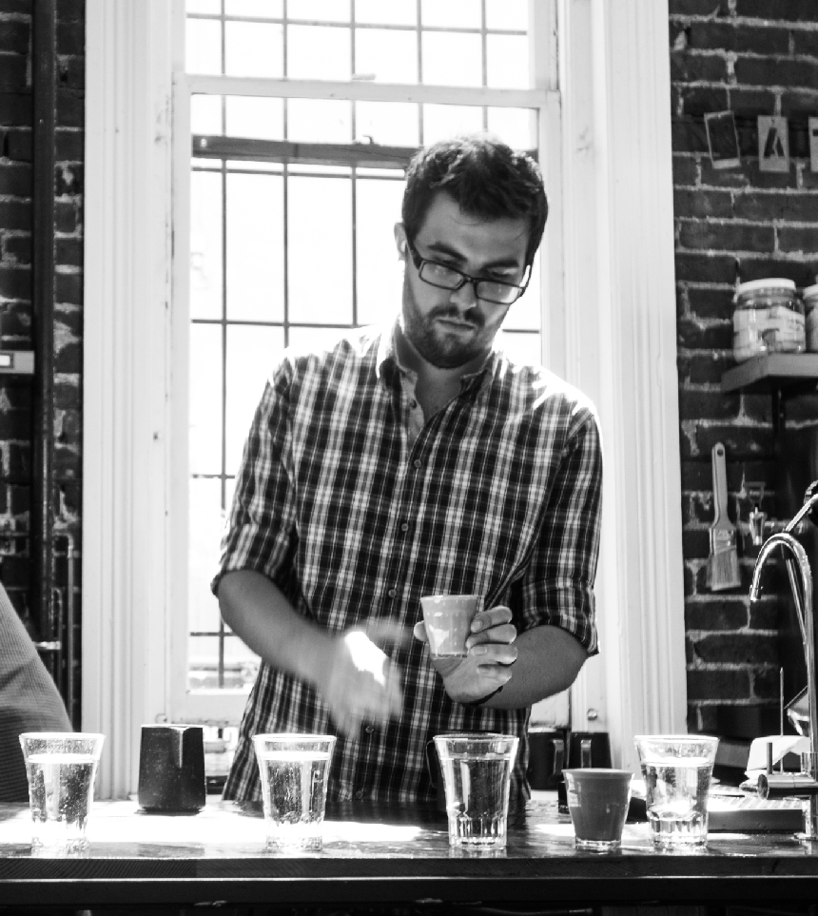
Our Solution
The research instrument was the questionnaire
Likert 5 scale closed-ended questions.
open-ended questions.

Slide 6
Conclusions and Recomendations
Marketing
Training
Assesment
Technology
The learners’ acceptance toward the blended learning courses in overall is at a very good level
There is no significant at the .05 level among different groups of learners

Slide 7
Further study
the acceptance of teachers in using blended learning
The proportion between online and in-person learning
Other approaches will also be taken into consideration
Marketing
Training
Assesment
Technology

Slide 8
Contact
Pradit Songsangyos
+ 66 8 1297 8939
pradit.s@siu.ac.th

Slide 9
Credits
FONTS
Aleo Free Font
http://fontfabric.com/aleo-free-font/
Lato Font
http://www.fontsquirrel.com/fonts/lato
IMAGE CREDITS
Fonts - this template uses free fonts you can download and install yourself.
Image 1
http://www.flickr.com/photos/thomaschung/9407289467/
Image 2
http://unsplash.com/post/55904523633/
Images - we used creative commons photos as placeholders. You can easily replace them.
Copyrights - This work is licensed under a Creative Commons License.

